Slide 1



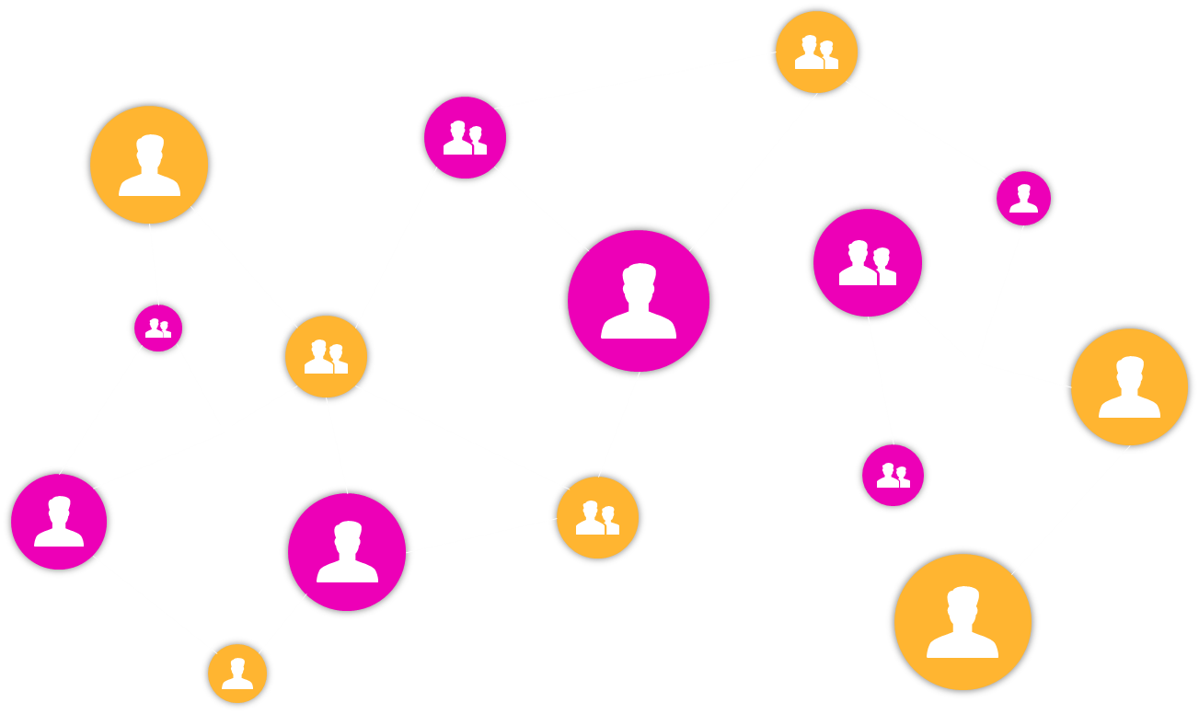
NATIONAL INSTITUTE OF TECHNOLOGY TIRUCHIRAPPALLI
CSPE43
ADVANCED DATA STRUCTURES AND ALGORITHMS

Slide 2
OPEN JOB SCHEDULING USING EDGE COLOURING OF GRAPH
DONE BY:
NAME
PRAJWAL SUNDAR
K ROSHAN
ROLL NUMBER
106121092
106121067

Slide 3

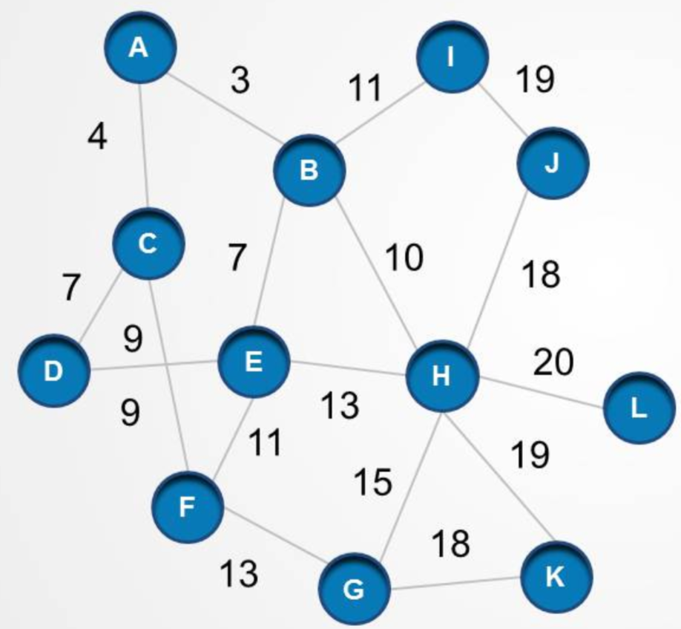
GRAPHS
A graph G is defined as an ordered set G(V, E) where V(G) represents the set of vertices and E(G) represents the set of edges which are used to connect these vertices.
CSPE43 – ADSA
OPEN JOB SCHEDULING USING EDGE COLOURING OF GRAPH

Slide 4
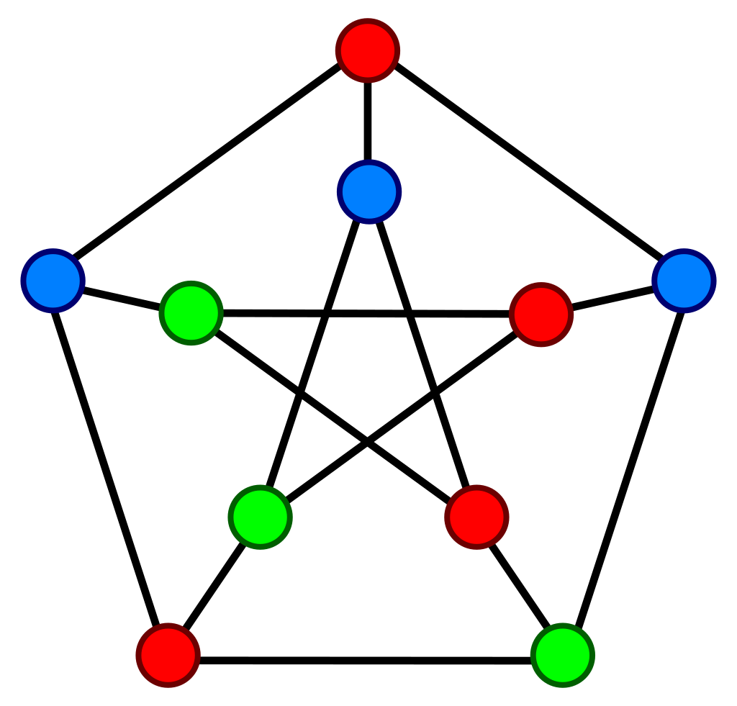
GRAPH COLORING
Graph coloring is a problem in graph theory that involves assigning colors to the vertices (or nodes) of a graph in such a way that no two adjacent vertices share the same color.
The goal of graph coloring is to find the minimum number of colors needed to color a given graph, which is known as the chromatic number of the graph.
CSPE43 – ADSA
OPEN JOB SCHEDULING USING EDGE COLOURING OF GRAPH

Slide 5
CHROMATIC NUMBER
The chromatic number can be described as the minimum number of colors required to properly color any graph. In other words, the chromatic number can be described as a minimum number of colors that are needed to color any graph in such a way that no two adjacent vertices of a graph will be assigned the same color.
Example: The chromatic number of the graph on the right is 3
CSPE43 – ADSA
OPEN JOB SCHEDULING USING EDGE COLOURING OF GRAPH

Slide 6
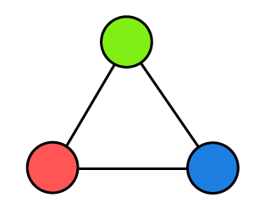
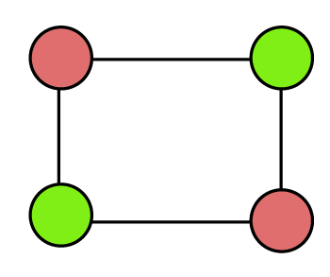
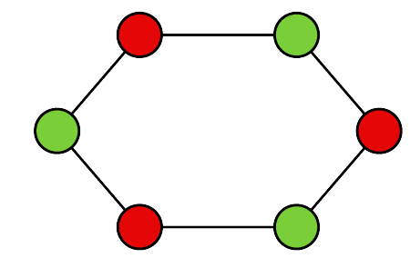
CHROMATIC NUMBER FOR VARIOUS TYPE OF GRAPHS
CYCLIC GRAPH
2, if the graph has even number of vertices
3, otherwise
Odd number of vertices
Chromatic Number = 3
Even number of vertices
Chromatic Number = 2
CSPE43 – ADSA
OPEN JOB SCHEDULING USING EDGE COLOURING OF GRAPH

Slide 7
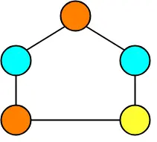
CHROMATIC NUMBER FOR VARIOUS TYPE OF GRAPHS
PLANAR GRAPH
Always less than or equal to 4
Chromatic Number = 3
CSPE43 – ADSA
OPEN JOB SCHEDULING USING EDGE COLOURING OF GRAPH

Slide 8
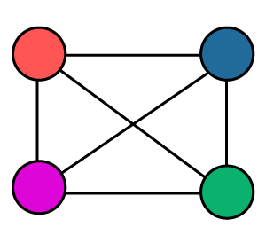
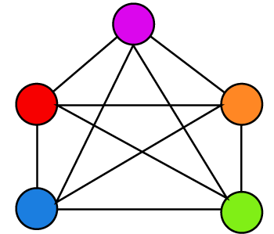
CHROMATIC NUMBER FOR VARIOUS TYPE OF GRAPHS
No. of vertices = 4
Chromatic Number = 4
COMPLETE GRAPH
Equal to the number of vertices of the graph
No. of vertices = 5
Chromatic Number = 5
CSPE43 – ADSA
OPEN JOB SCHEDULING USING EDGE COLOURING OF GRAPH

Slide 9
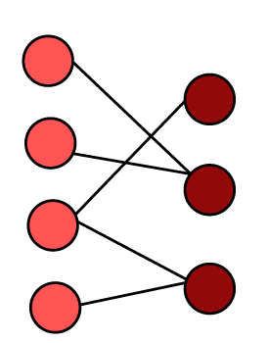
CHROMATIC NUMBER FOR VARIOUS TYPE OF GRAPHS
BIPARTITE GRAPH
Always equal to 2
Chromatic Number = 2
CSPE43 – ADSA
OPEN JOB SCHEDULING USING EDGE COLOURING OF GRAPH

Slide 10

OPEN JOB SCHEDULING
Open job scheduling is an optimization problem in computer science and operations research.
The input to the open job scheduling problem consists of a set of n jobs, another set of m workstations, and a two-dimensional table of the amount of time each job should spend at each workstation (possibly zero).
The goal is to assign a time for each job to be processed by each workstation, so that no two jobs are assigned to the same workstation at the same time, no job is assigned to two workstations at the same time, and every job is assigned to each workstation for the desired amount of time.
CSPE43 – ADSA
OPEN JOB SCHEDULING USING EDGE COLOURING OF GRAPH

Slide 11
OPEN JOB SCHEDULING USING GRAPH COLOURING
In this project, we are going to solve the open job scheduling problem, by using Graph Coloring, in other words, Vertex Coloring.
Here, we take all the jobs as the vertices of a graph. Each vertex represents a job.
There are 2 types of jobs
Dependent Jobs
Independent Jobs
The idea is that we will introduce an edge between 2 vertices, if the jobs associated with the vertices are dependent on each other.
Once this is done, we will start to color the graph according to the constraints of the graph coloring algorithm.
The chromatic number of the graph will determine the minimum number of distinct time slots we need to have in order to complete all the jobs.
We can also say that the jobs associated with the vertices of the graph which have the same color can be scheduled at the same time, meaning they can be done simultaneously (as they are independent of each other)
METHODOLOGY
CSPE43 – ADSA
OPEN JOB SCHEDULING USING EDGE COLOURING OF GRAPH

Slide 12
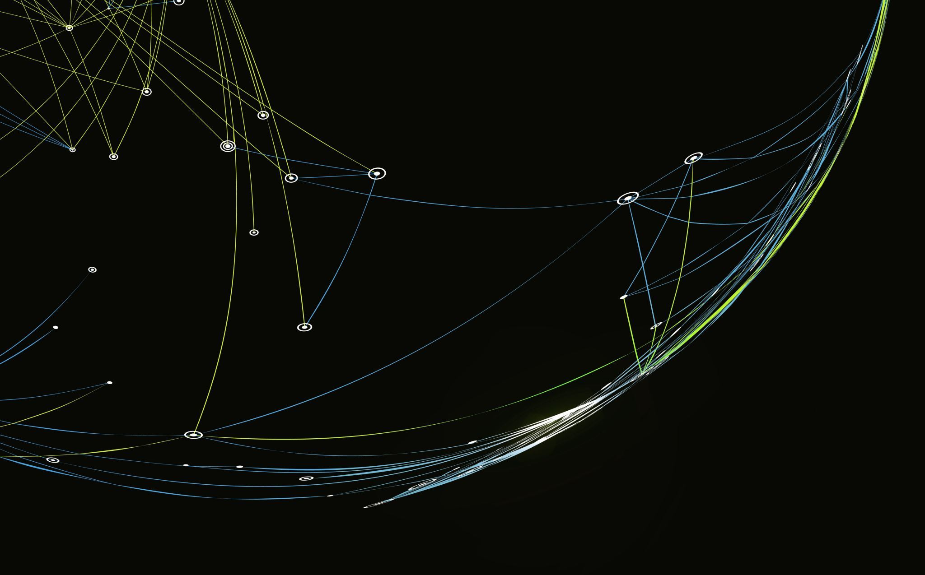
THANK YOU

